Slide 1

Web fundamentals
HTML and CSS

Slide 2
Chapter 2 Relative links
Notes:
Short overview of topic…

Slide 3
Objectives
In this chapter, you will learn:
That web sites consist of many files, often in a complex folder structure.
How to reference other files on your web site, in images, and in hyperlinks.
Other places you can put your CSS besides the <head> section.

Slide 4
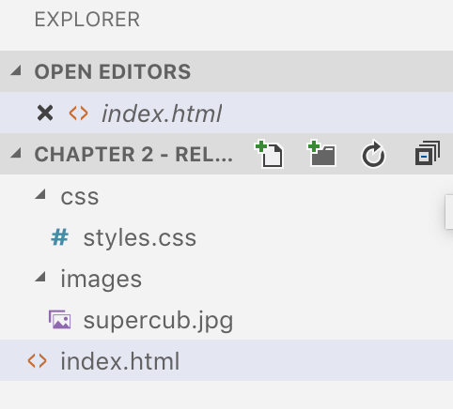
Folders
Websites often have folders and sub-folders, just like the documents on your computer.

Slide 5

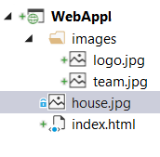
Relative and absolute path
Image in the same folder as the html page:
<img src="house.jpg" alt="Image of house" />
Image in the images sub-folder where the html page is located:
<img src="images/team.jpg" alt="QA team picture" />
Image in root folder:
<img src="/images/logo.jpg" alt="QA logo" />
Image from a URL:
<img src="http://qa.somee.com/html/slides/team.jpg" alt="QA team picture" />
If the URL begins with http:// or similar, it is a link to another website.
If it begins with a / then it is relative to the web site’s home folder.
If it does not begin with either of these, it is relative to the current folder.

Slide 6
Inline CSS
So far, we have seen internal style sheets.
There are two other places you can put your CSS.
The first of these is ‘inline:’
This means the CSS is part of the tag.
The CSS applies only to the tag where it is inlined.
Add a ‘style’ attribute to a tag:
The value of this attribute is made up of CSS property / value pairs.
Example:
<p style="color:blue;font-style:italic">
This paragraph is blue and italic

Slide 7
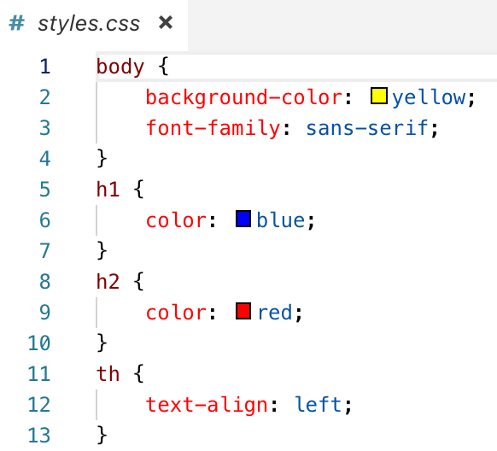
External style sheets
You can put CSS is in an external style sheet:
A file with a .css extension.
Can be on another website, or on the same website (relative link).
Has the same format as internal CSS:
But without the <style> tags.
To include a stylesheet in your page:
Note:
<link> appears instead of <style>.
The “rel” attribute is required.
<link rel="stylesheet" href="styles.css">

Slide 8
In this chapter, you learned:
That websites consist of many files, often in a complex folder structure.
How to reference other files on your website, in images, and in hyperlinks.
Other places you can put your CSS besides the <head> section.
Summary

Slide 9
Lab
In this lab, you will take the page you created during pre-learning, and you will:
Change the image so that instead of being on another website, it uses a relative link. to access a copy on your own website
Change the CSS so it uses an external stylesheet.
Chapter 2 - Relative Links.docx

